Slide 1
Nextflow fundamentals training
Albert Palleja Caro
on behalf of
Data Science Platform
27th November 2024

Slide 2
Outline of the theoretical part
What is Nextflow?
Behind nextflow
Why do we need a Community effort?
Nextflow - Basic concepts
Nextflow’s core features
A Nextflow script
Installing Nextflow and running the first scripts
Nextflow and Azure batch
nf-metagenomics pipeline
Resources

Slide 3

Context
Experiments and analyses on large datasets
Portable
Big Data
Reproducible
Workflows: using computers to collect, store and analyze and disseminate data information
Handle small and large files (e.g. genomics)
Many programmimg languages and different softwares
Complex interactions and dependencies between the softwares
Parallellize jobs
Distribute computing
Great support for all that!
Notes:
The rise of big data has made it increasingly necessary to be able to analyze and perform experiments on large datasets in a portable and reproducible manner. Parallelization and distributed computing are the best ways to tackle this challenge, but the tools commonly available to computational scientists often lack good support for these techniques, or they provide a model that fits poorly with the needs of computational scientists. Nextflow was particularly created to address these challenges.

Slide 4
Nextflow is a software - Workflow orchestrator engine
Nextflow is a Domain-specific language (DSL) built on top of Groovy
It allows writting data-intensive computational workflows
It accommodates many languages, software environments, and computing environments
It is oriented to bioinformatics analyses
There is an active community developing and maintaining 113 different bioinformatics analyses (on date: 27th November 2024)

Slide 5

Behind Nextflow
Open Science
Make science more open!
Notes:
Keyword behind Nextflow and tech related:
Open science - Is a current movement! Make Science more open! Nextflow is helping on that!

Slide 6

Behind Nextflow
Open source
What this software is doing?
(parameters, versions, functions reused/inherited)
Notes:
To have open science we need to know software, params, options, method used and have access to the source code to be sure of what we are doing. Nextflow is opn source.

Slide 7
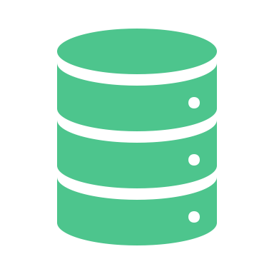
Behind Nextflow
Open Data
Which data are we handling?
How was measure, which technology,units, etc…
FAIR principles
Notes:
Also important to have open data, how was measeure, what are the units, where to find it how to access it

Slide 8

Behind Nextflow
Open community
A community that their members interact to each other and collaborate
nf-core → pipelines
Slack chat community
Notes:
If you have open science, source and data then Nextflow to orchestrate the anaylses then you have an open community. Nextflow advocates for an open community with multiple channels to interact and connect people, fprums, Slack channels, conferences, hackathons regularly organized and that share, curate and maintain > 100 bioinformatics pipelnes, for example in nf-core collection of nesxtflow pipelines)

Slide 9

Behind Nextflow
Genomics workflows
First pipelines meant for that, large files per samples with many rows and columns,different formats (binary, tab separated, etc..) parallel processess, different sorftware, languages (python, R, matlab, …), takes decisions for the next processes
Notes:
Originally thought for Genomics data with large files and heterogeneity of the data
Files in different formats and sizes
Parallel process
Different software
Different programming languages
Decisions may be need to be taken at some point of the pipeline on the fly, this software or another, etc…
Nextflow can handle all that!

Slide 10
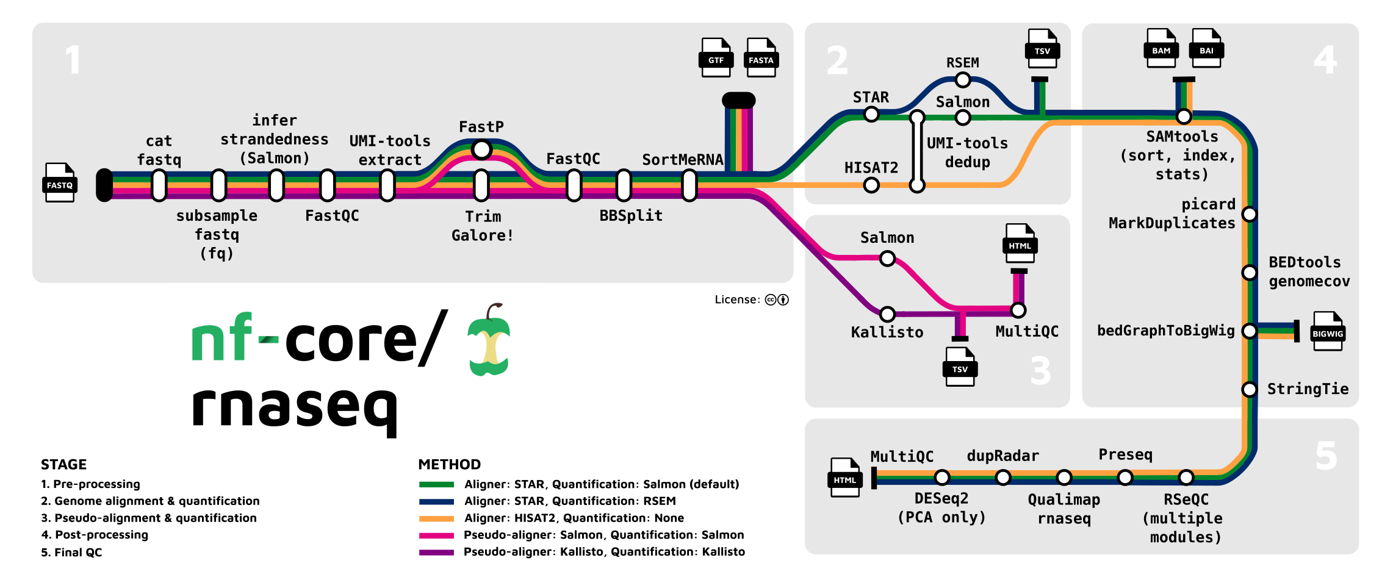
A nextflow pipeline in metro map

Slide 11
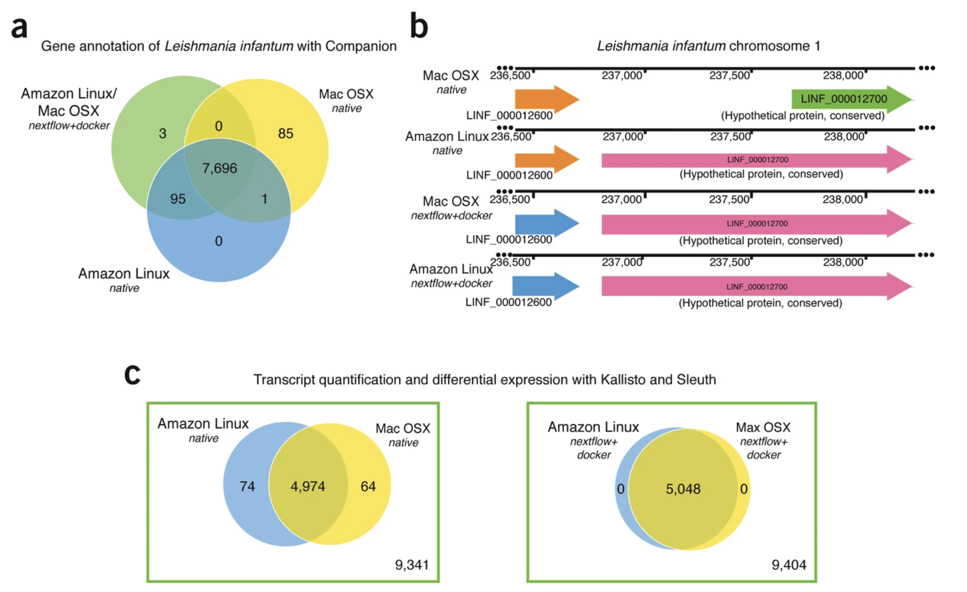
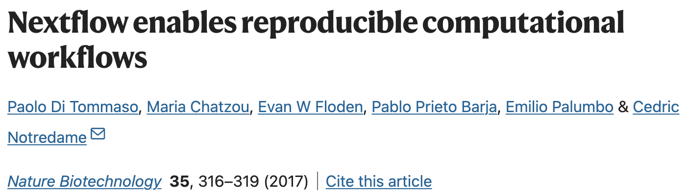
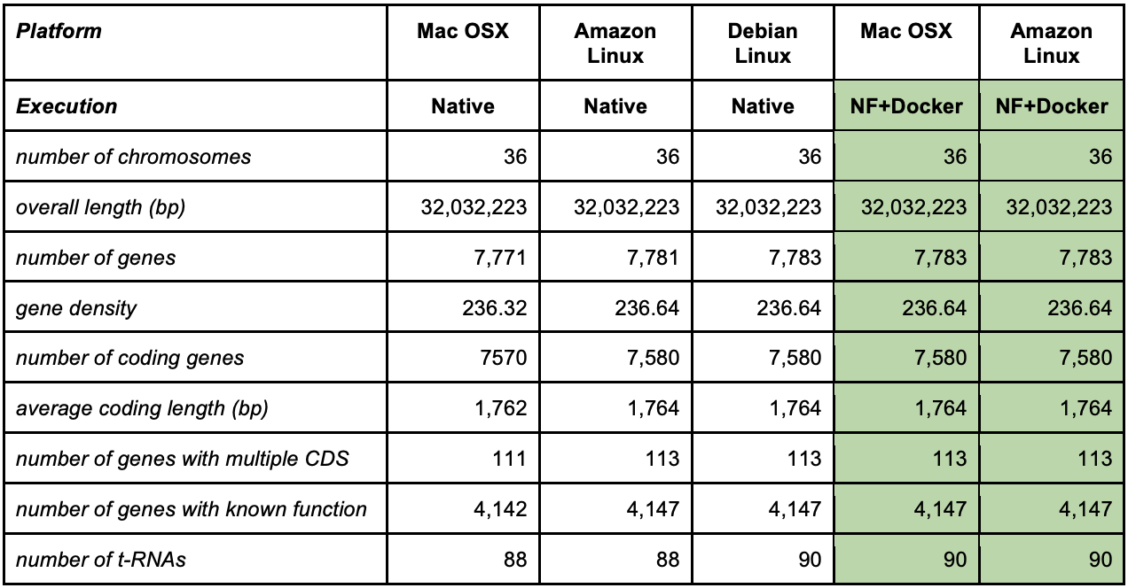
Why do we need a Community effort?
Reproducibility and even repeatability is challenging even if you are very careful keeping the same, params, versions, etc…!!!
Different results with different environments
different gene annotations working in different environments. This does not happen working in containers
Notes:
(a) Leishmania infantum clone JPCM5 genome annotation was carried out using either a native or a dockerized (Debian Linux) version of the Companion eukaryotic annotation pipeline. The native and dockerized versions were run on both Mac OSX and Amazon Linux platforms. The Venn diagram, plotted using the annotated genes, reveals small discrepancies when comparing the genomic coordinates of predicted coding genes, non-coding RNAs, and pseudogenes. (b) Some disparities included the annotation of the same genes at different genomic coordinates. Completely identical annotations were obtained when using the dockerized version on either the Mac OSX or Amazon Linux platforms. (c) Comparison of the Kallisto and Sleuth pipelines, applied to find differentially expressed genes (q-value < 0.01) in an RNA-seq experiment, using data from human lung fibroblasts, revealed differences when carried out on either the Mac OSX or the Amazon Linux platform. Both platforms produced identical readouts when deploying the dockerized version of the pipeline. All analyses were carried out at least twice and checked for numerical stability.

Slide 12
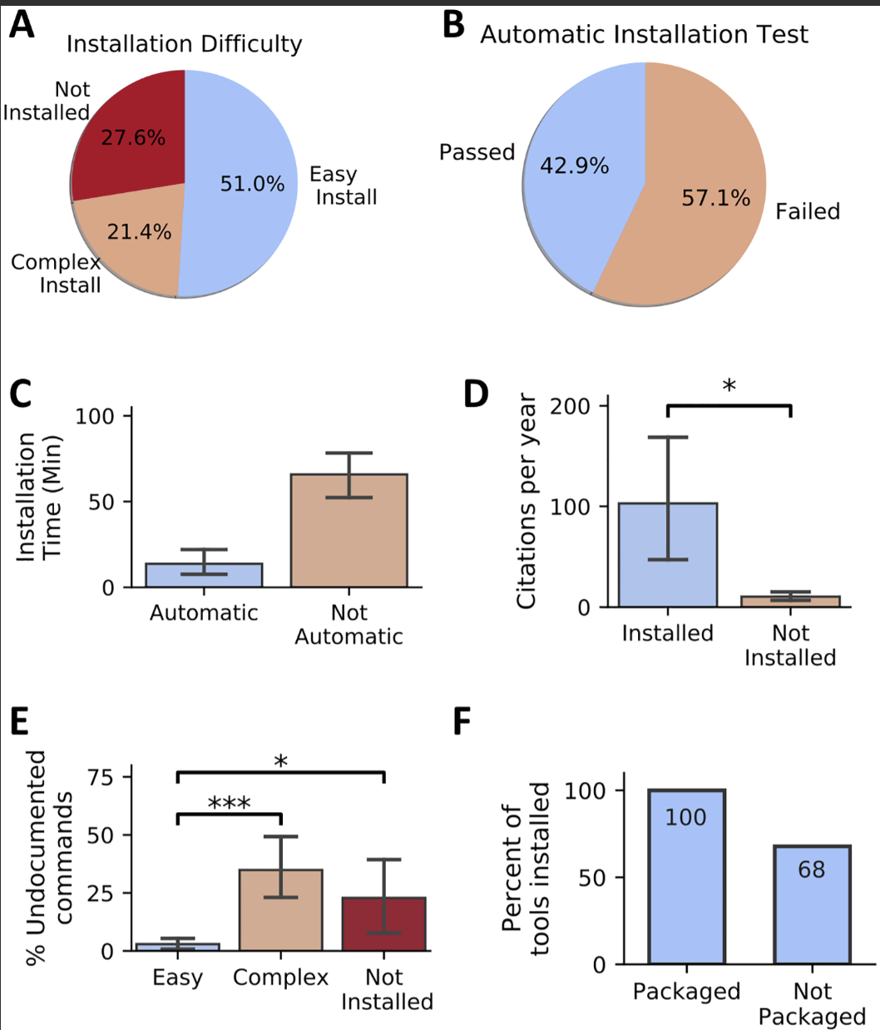
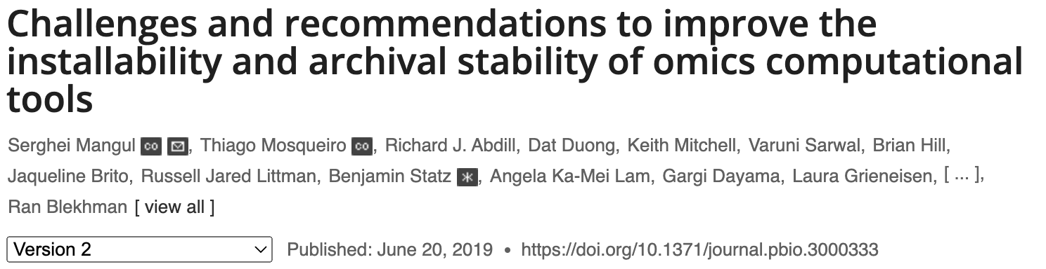
Why do we need a Community effort?
28% of all omics software resources are currently not accessible through URLs published
Among the tools found, 49% were difficult to install or could not be installed at all!
Notes:
(a) Leishmania infantum clone JPCM5 genome annotation was carried out using either a native or a dockerized (Debian Linux) version of the Companion eukaryotic annotation pipeline. The native and dockerized versions were run on both Mac OSX and Amazon Linux platforms. The Venn diagram, plotted using the annotated genes, reveals small discrepancies when comparing the genomic coordinates of predicted coding genes, non-coding RNAs, and pseudogenes. (b) Some disparities included the annotation of the same genes at different genomic coordinates. Completely identical annotations were obtained when using the dockerized version on either the Mac OSX or Amazon Linux platforms. (c) Comparison of the Kallisto and Sleuth pipelines, applied to find differentially expressed genes (q-value < 0.01) in an RNA-seq experiment, using data from human lung fibroblasts, revealed differences when carried out on either the Mac OSX or the Amazon Linux platform. Both platforms produced identical readouts when deploying the dockerized version of the pipeline. All analyses were carried out at least twice and checked for numerical stability.

Slide 13
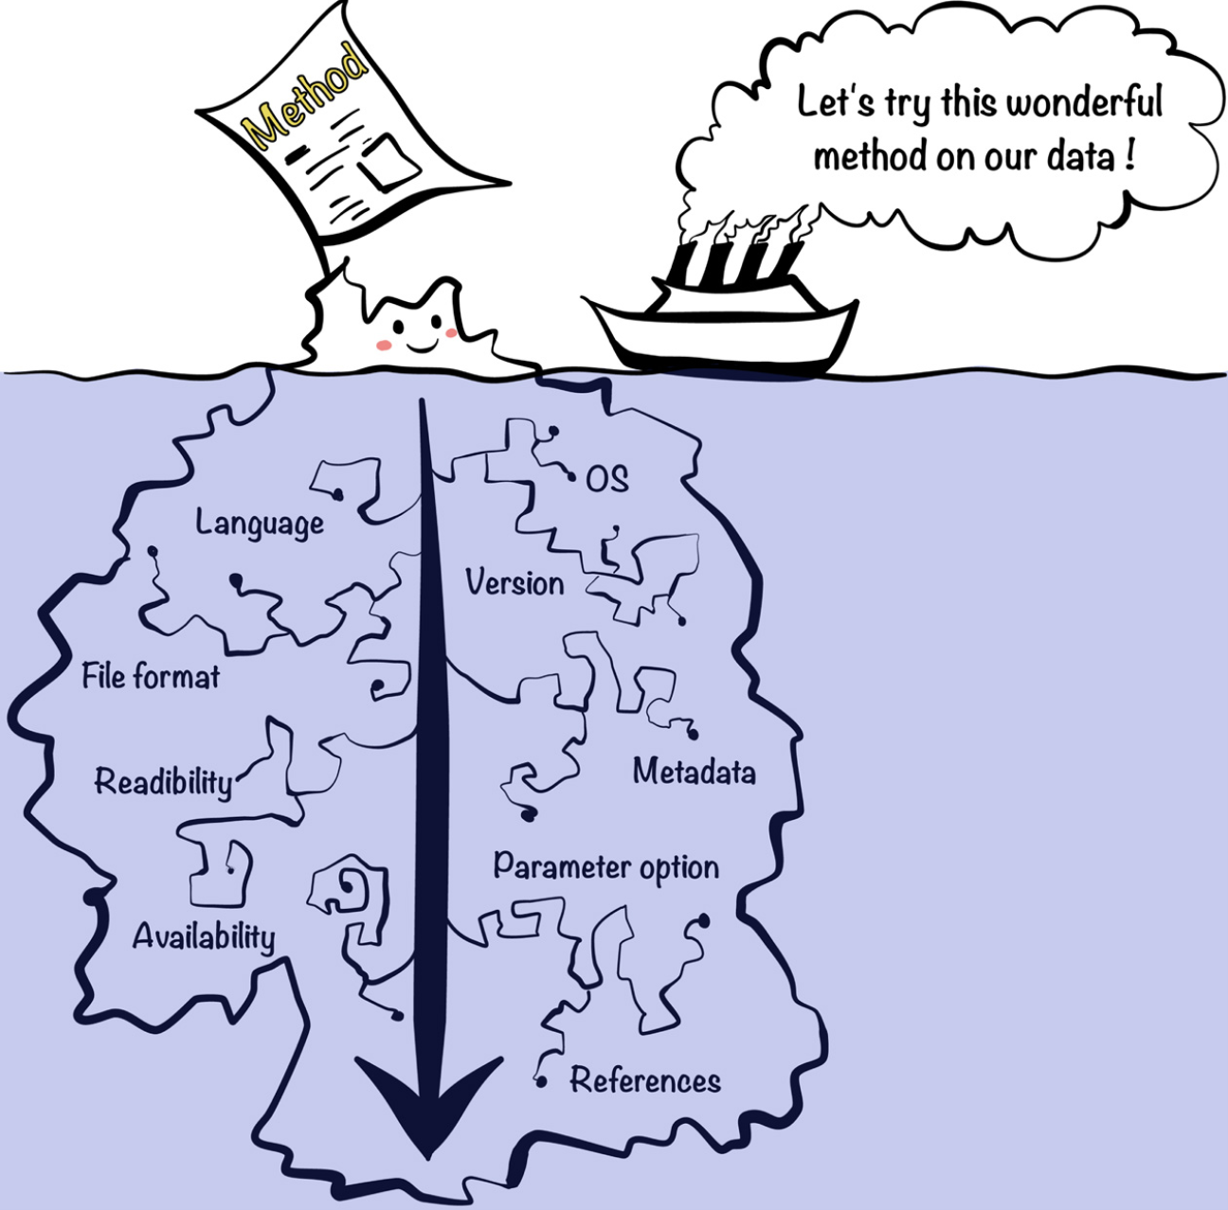
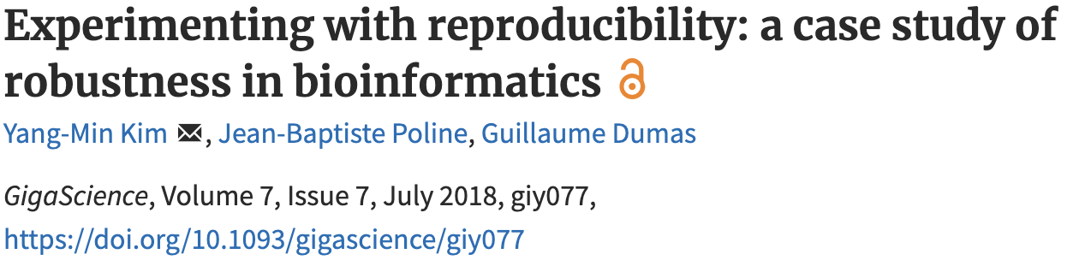
Why do we need a Community effort?
"First we tried to rerun the analysis with the code and the data provided by the authors. Second we reimplemented the whole method in a python package.."
If you could use a tool to download, organize and orchestrate all these software / params / versions, etc… and achieve repeatable and reproducible results wouldn’t you use it?
Notes:
(a) Leishmania infantum clone JPCM5 genome annotation was carried out using either a native or a dockerized (Debian Linux) version of the Companion eukaryotic annotation pipeline. The native and dockerized versions were run on both Mac OSX and Amazon Linux platforms. The Venn diagram, plotted using the annotated genes, reveals small discrepancies when comparing the genomic coordinates of predicted coding genes, non-coding RNAs, and pseudogenes. (b) Some disparities included the annotation of the same genes at different genomic coordinates. Completely identical annotations were obtained when using the dockerized version on either the Mac OSX or Amazon Linux platforms. (c) Comparison of the Kallisto and Sleuth pipelines, applied to find differentially expressed genes (q-value < 0.01) in an RNA-seq experiment, using data from human lung fibroblasts, revealed differences when carried out on either the Mac OSX or the Amazon Linux platform. Both platforms produced identical readouts when deploying the dockerized version of the pipeline. All analyses were carried out at least twice and checked for numerical stability.

Slide 14
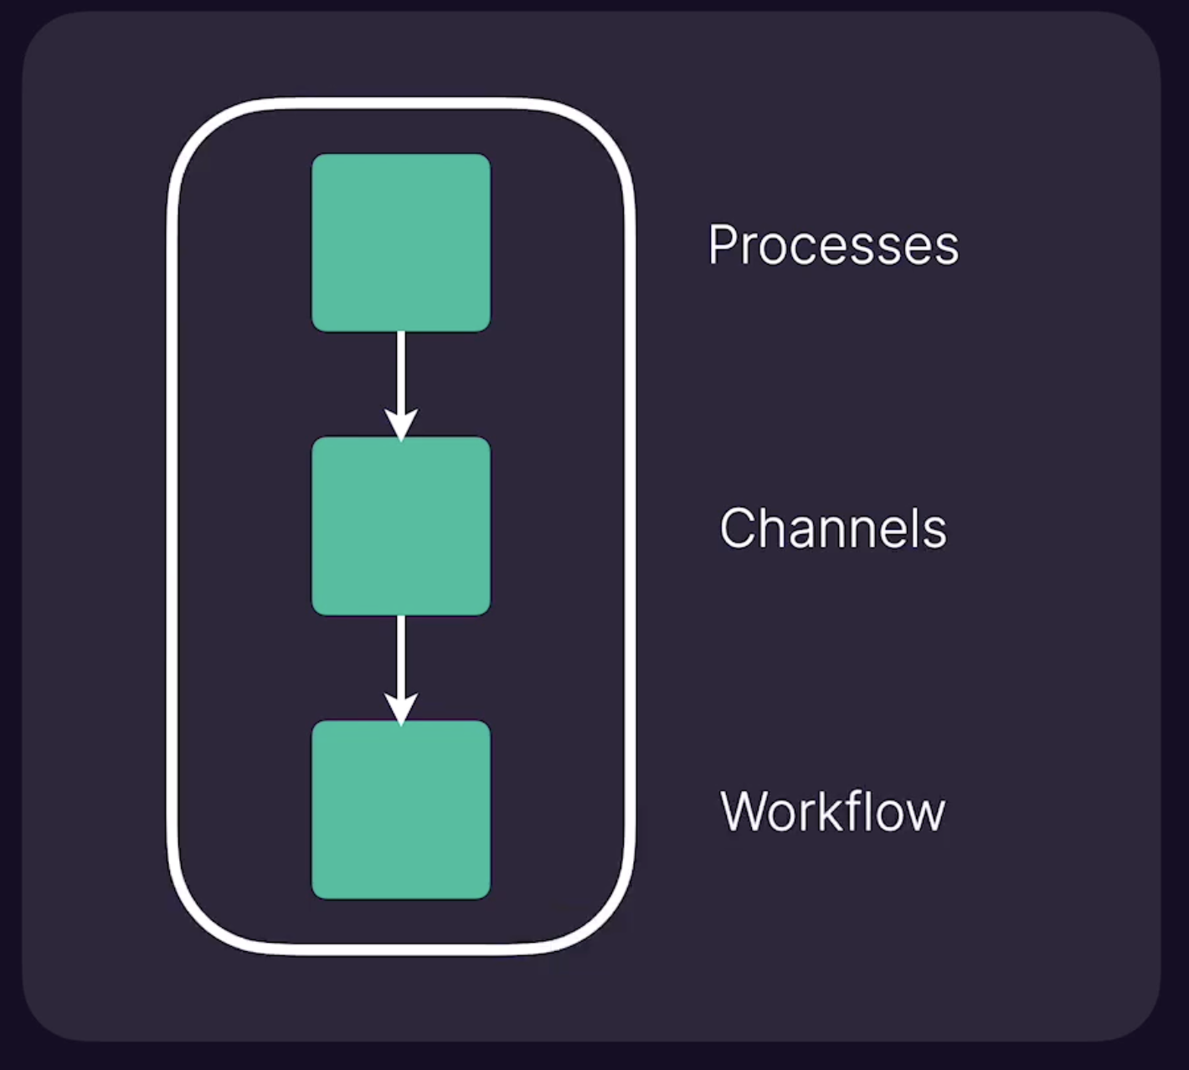
Nextflow – Basic concepts
Nextflow is a software - Workflow orchestrator engine
Nextflow is a Domain-specific language (DSL) built on top of Groovy
It allows writting data-intensive computational workflows
Notes:
Nextflow is …
Nextflow is based on few primitives:
Process is every step in your pipeline and they are executed independently isolated from each other
We need something to share inputs and outputs between processes
When you have a set of processes and channels coonecting them we have a workflow

Slide 15
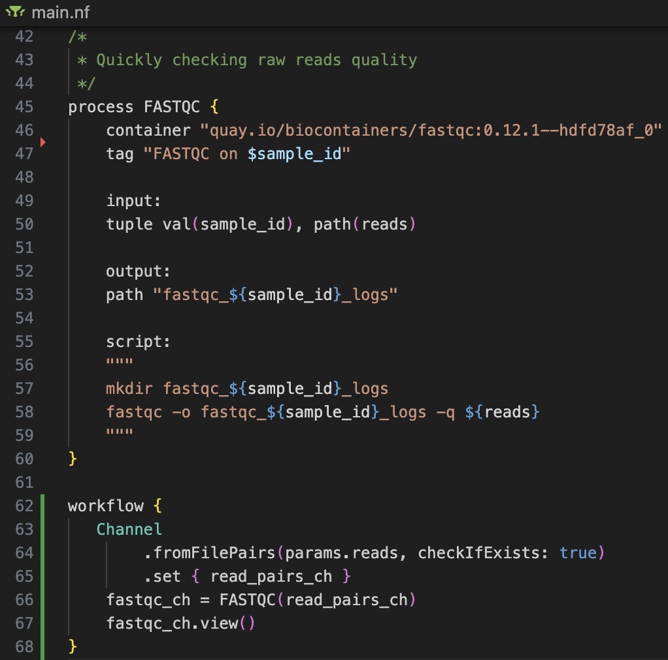
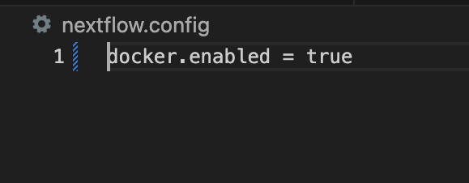
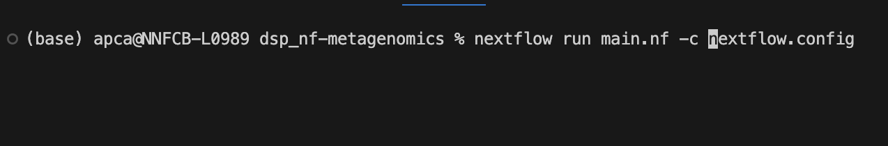
A Nextflow script
The .nf files are workflow scripts
The file nextflow.config is a configuration file that sets minimal environment properties
Directives
Process
Code block
How to run it:
Channel
Workflow

Slide 16
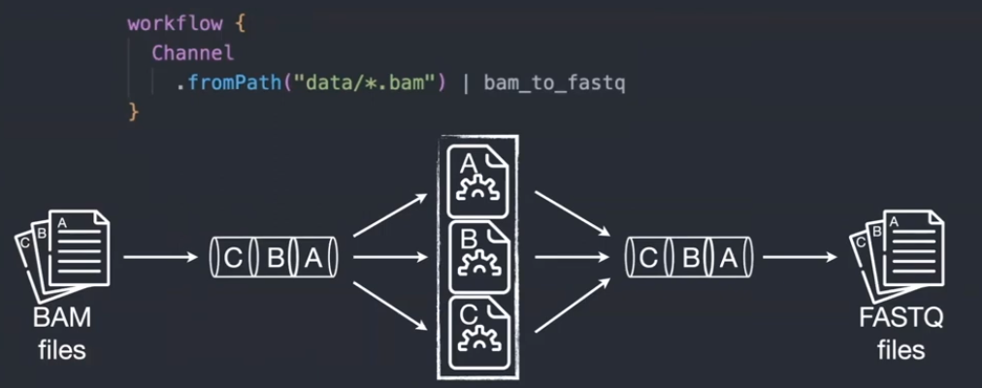
Nextflow – Interesting features
Implicit parallelism (tasks in a process are run by default in parallel)
Reentrancy (resume partial runs, do not need to rerun the entire pipeline of something went wrong, it starts from where it stopped)
Reusability (use different modules, subworkflows, written and containerized by the Nextflow community)
Notes:
You can reuse the modules and subworkflows written by the community to build your workflows

Slide 17
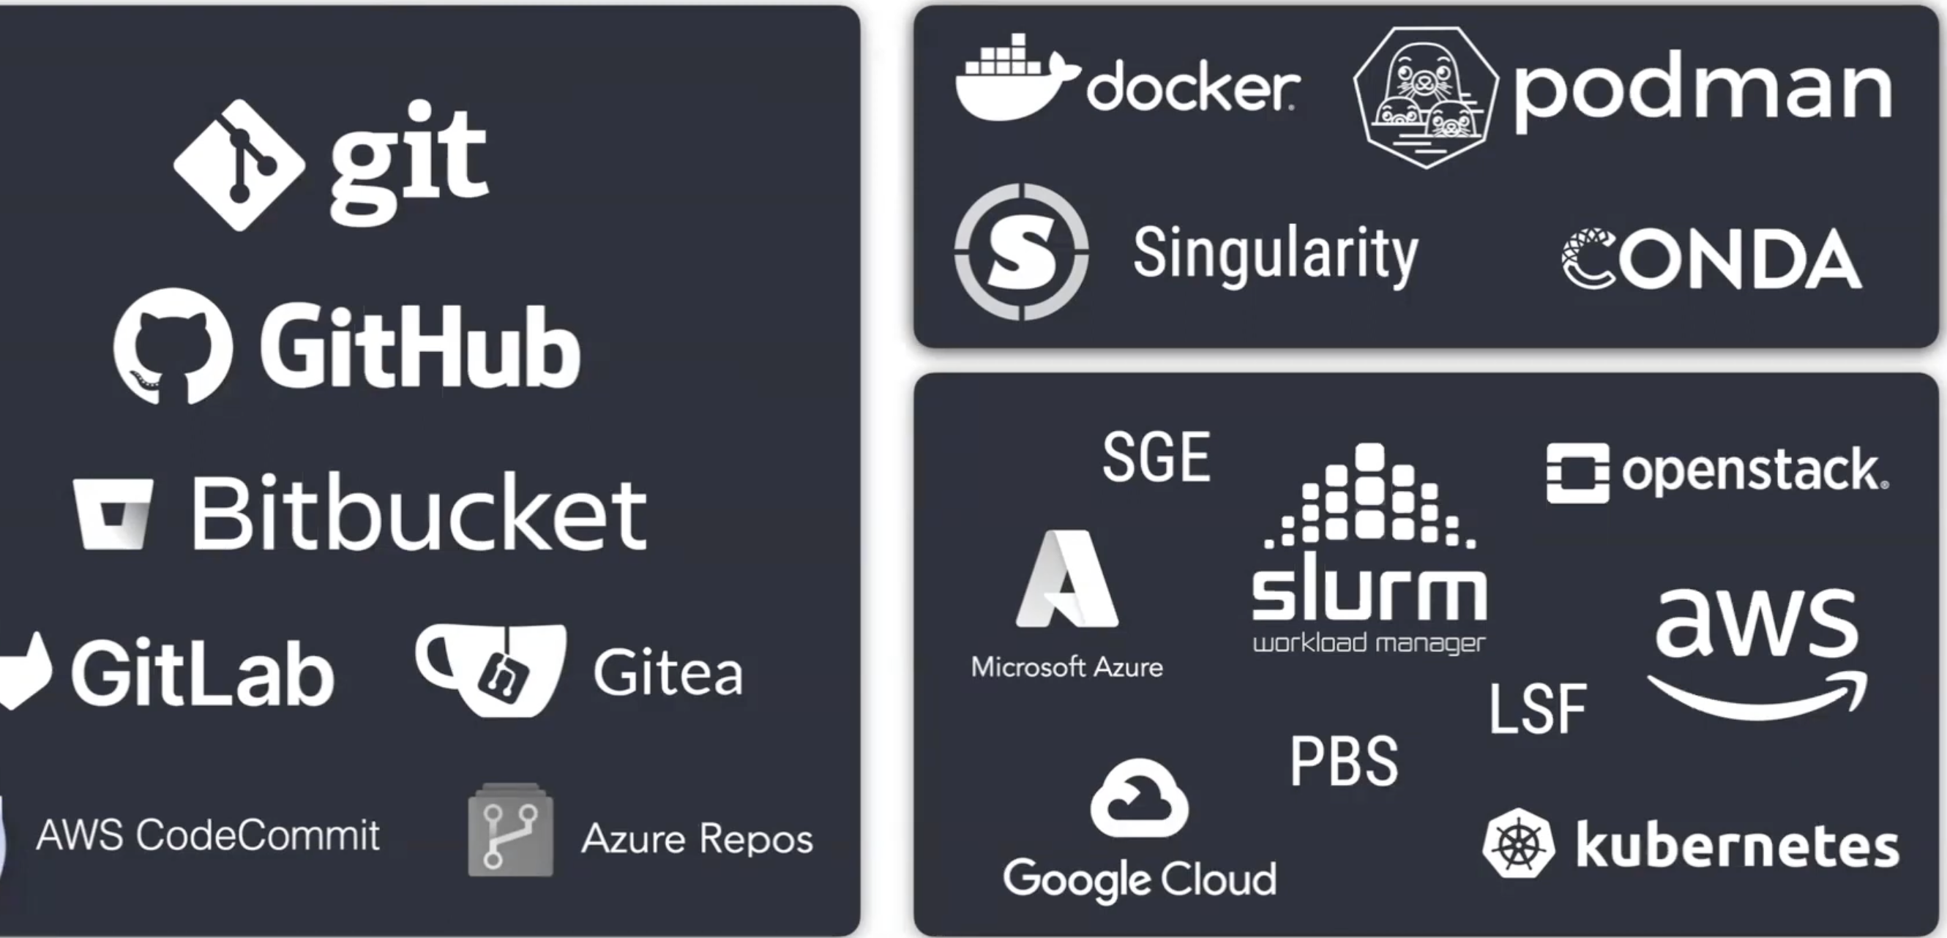
Languages, Software and computing environments
Nextflow works with all main languages and version control providers
Regarding software environments where to execute the code it works with most of the container solutions
Same thing for computing environments
Languages
Software
Compute
Notes:
Nextflow is a software and a language to build your workflow
We need software to run the pipeline and an environment to run it
Language it supports many version controlled you can host your code there and run it directly from Nextflow
What it comes to software Nextflow supports many containerizing options like Docker, Singularity or Conda environments
For computing environments supports the main cloud infrastructures and ,ost of the job schedulers of HPC

Slide 18



Nextflow’s core features
Reproducible between runs
integration with code management tools
all packages downloaded, organized in containers, and control over computing environment
Portable between systems
write the code in your laptop and can run everywhere
works with most of computing environments
Scalable
can be run for 10 on your laptop or thousands of samples in an HPC or the cloud
Integration of existing tools, systems, and industry standards

Slide 19
nf-core
A community effort inside nextflow community to colloect a curated set of analysis pipelines built using Nextflow
Cooperation – community development
Standards – Use common templates
Collaboration – No duplicate pipelines within nf-core
Helper tools
Compatibility
Components
113 different pipelines
Subworflows
Modules – software wrappres > 1000
Linting – Conventions to test
Schema - Validations
Tooling

